Slide 1
Algorithm Walkthrough
Zelong Wang
Supervisor: Michael Reiss,
Dr. Wouter-Jan Rappel

Slide 2
Agenda
Two classes
Main functions walkthrough
Demo

Slide 3
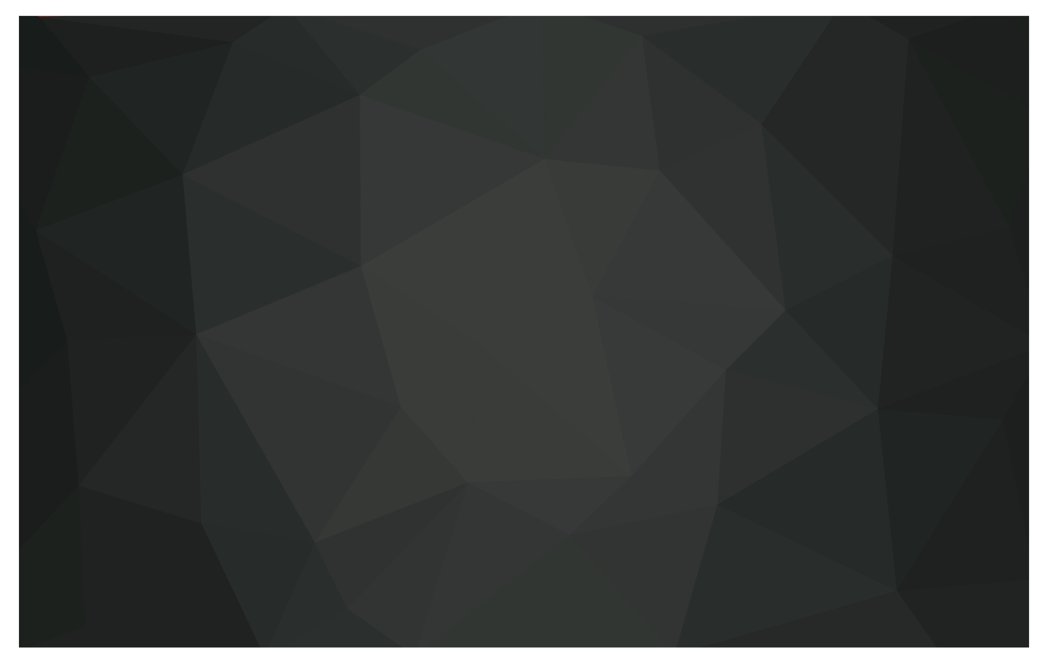
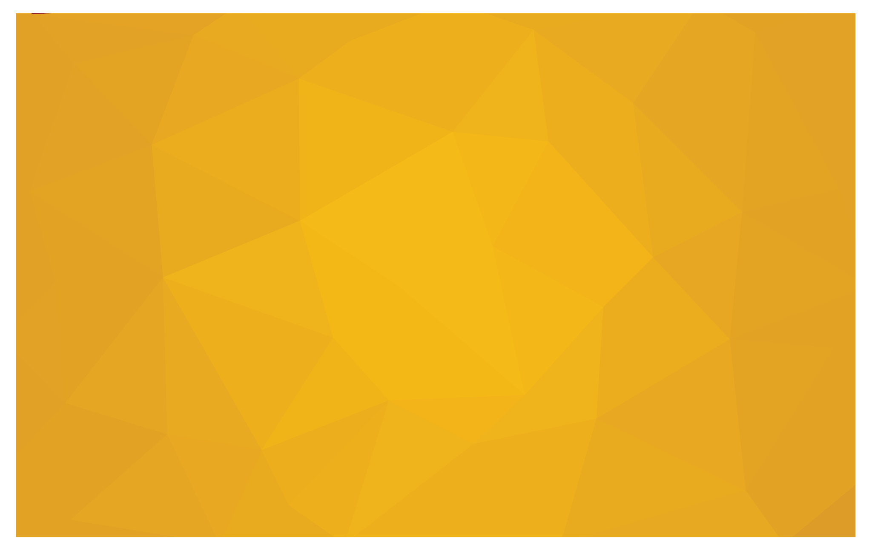
Class one: WaveExtract.py
Class Two:
SpeedMeasure.py
It is used to extract waves into labeled black-white mask from original raw videos. It’s mostly the same workflow mentioned in my last presentation.
It is used to convert the labeled videos into activation maps and then measure the speed.

Slide 4
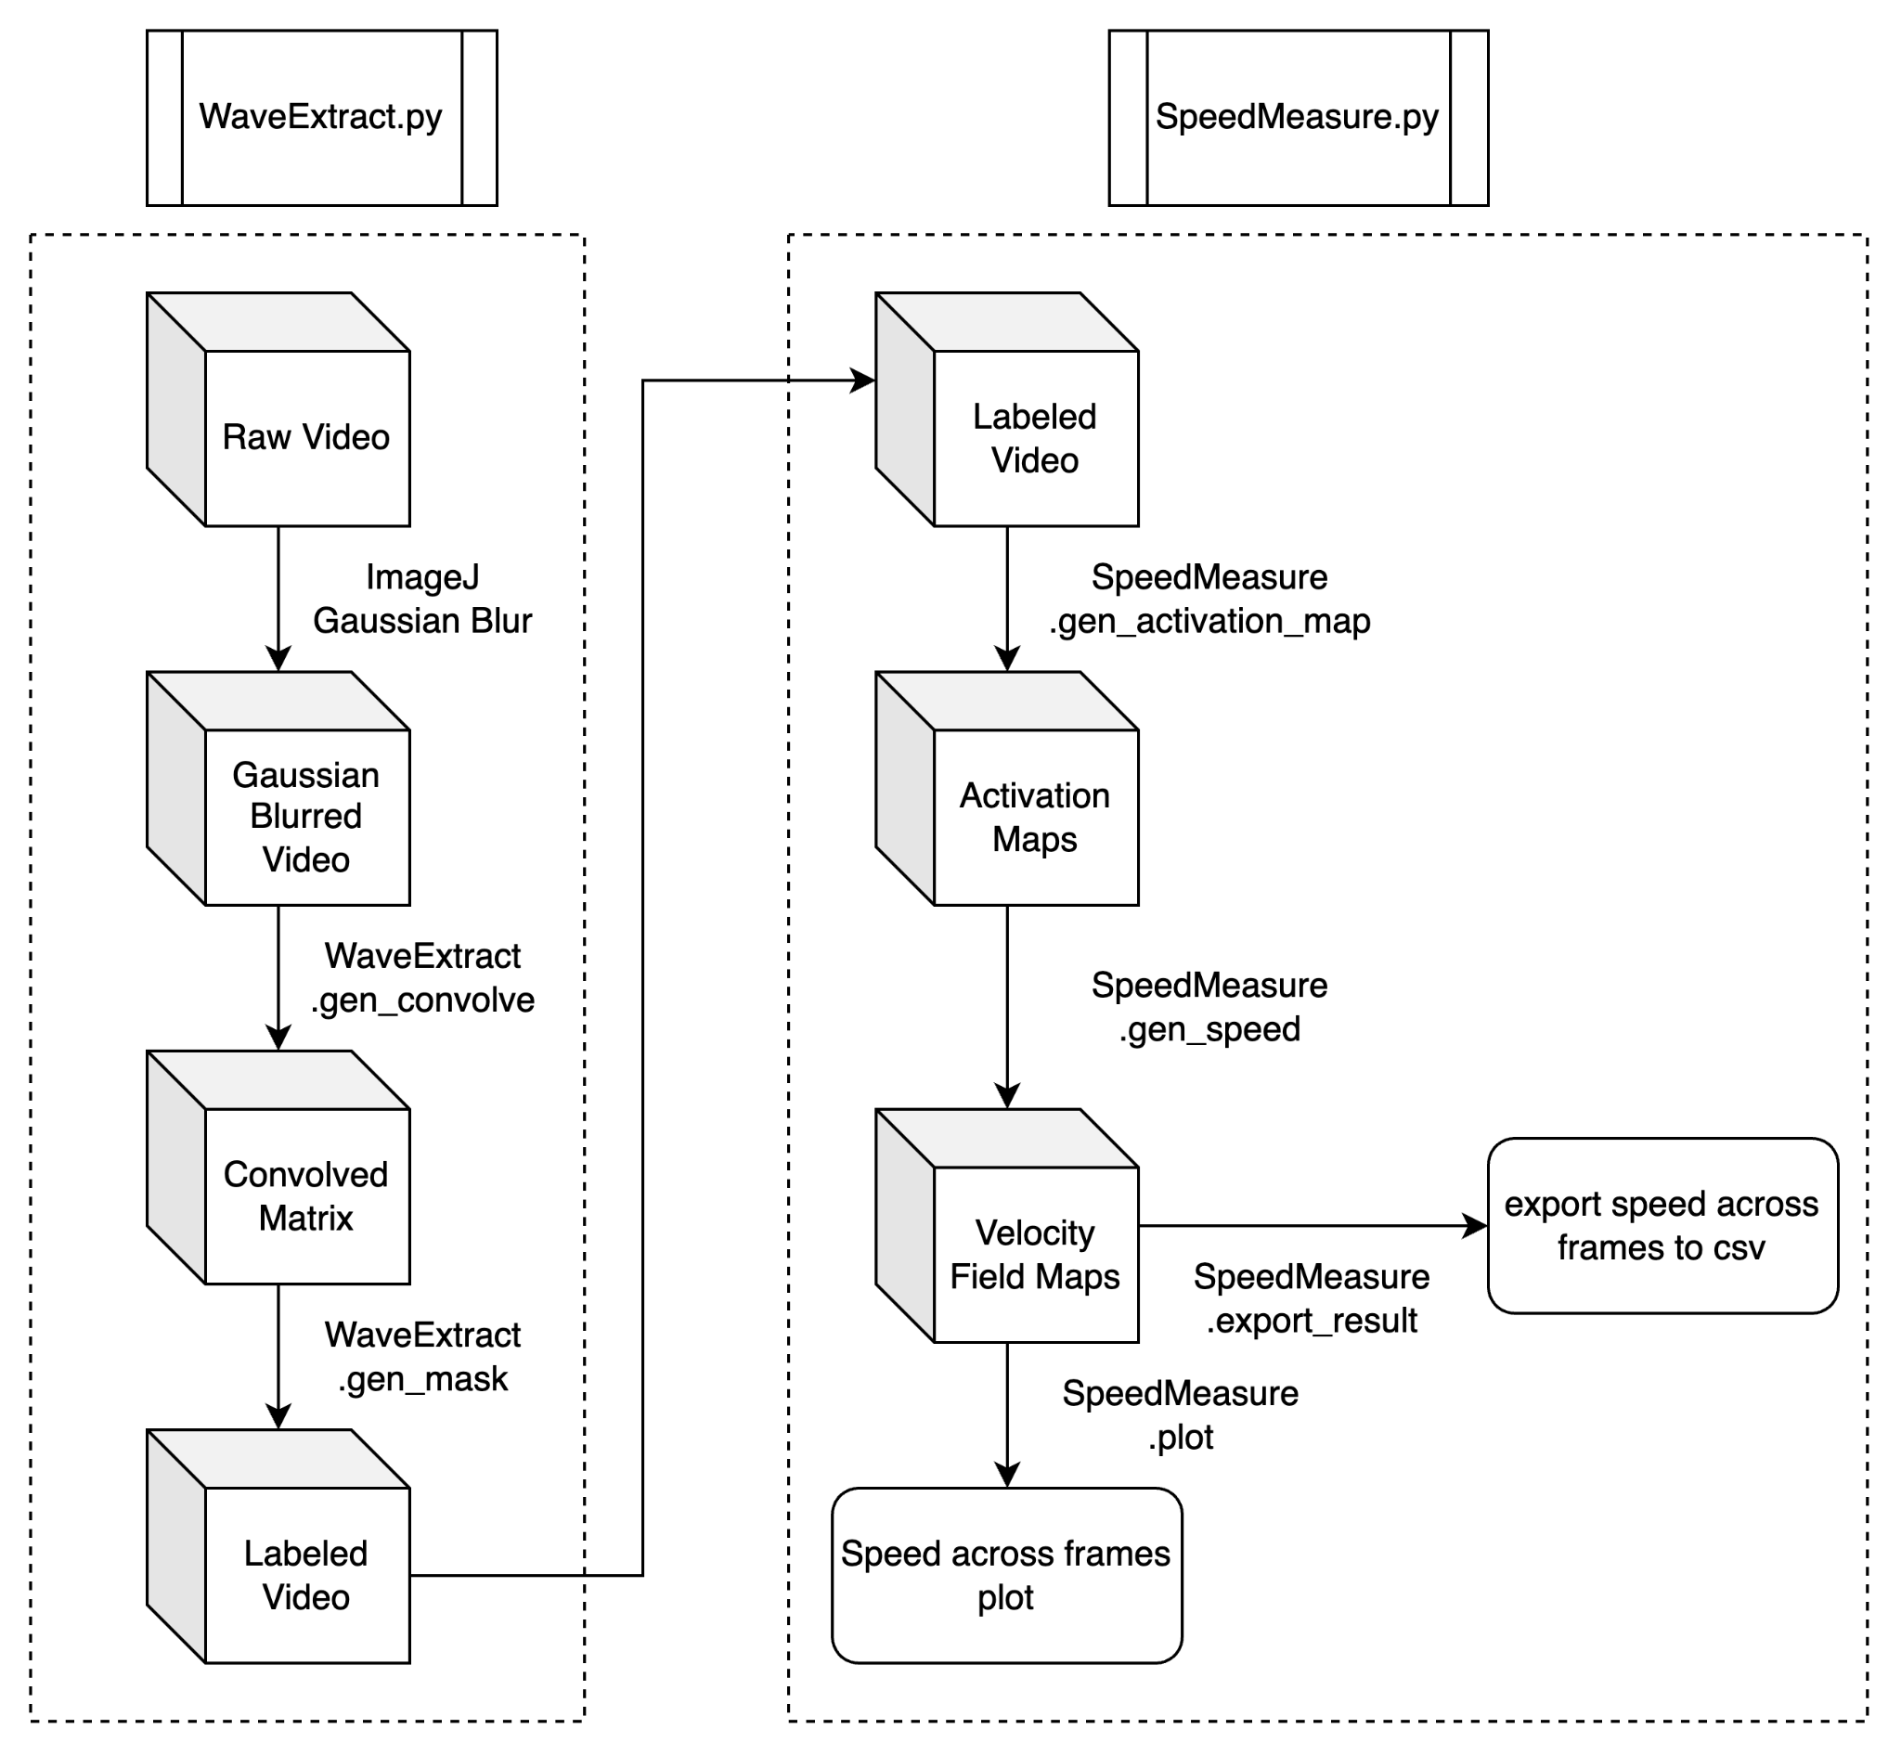

Slide 5
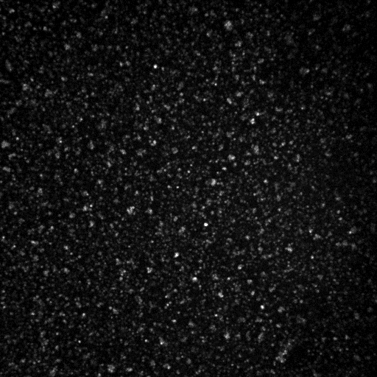

Slide 6
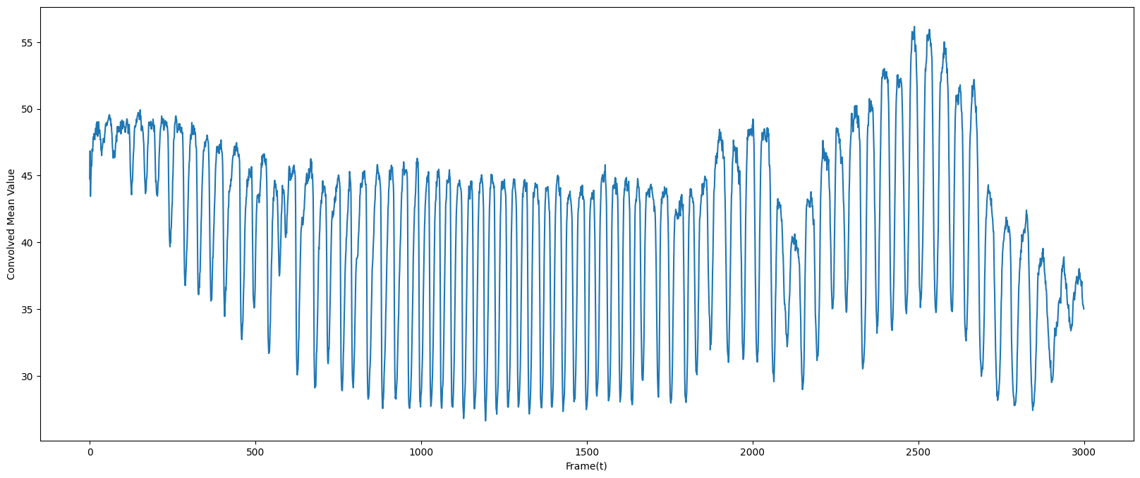
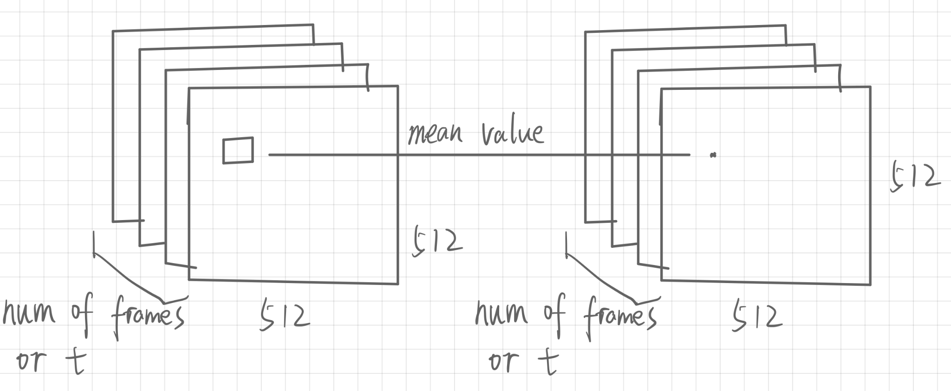

Slide 7
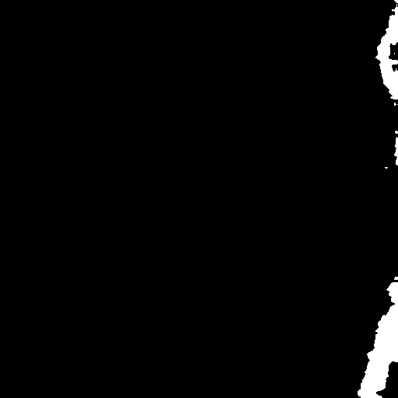

Slide 9

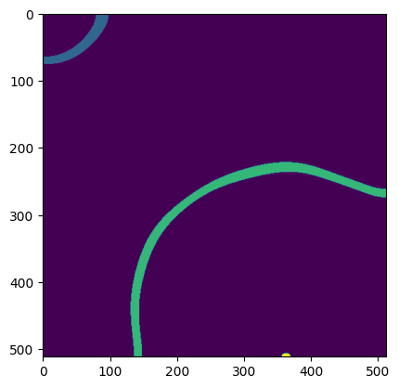
SpeedMeasure.gen_activation_map

Slide 10
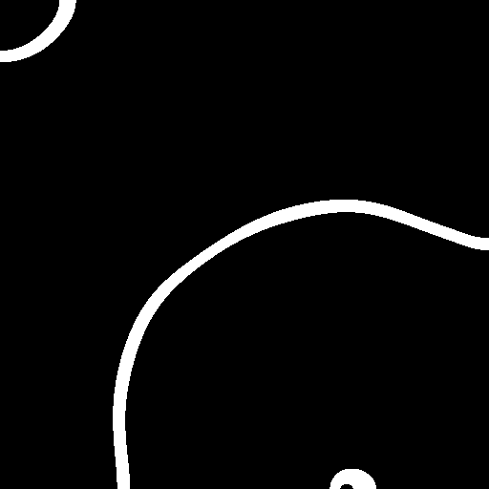
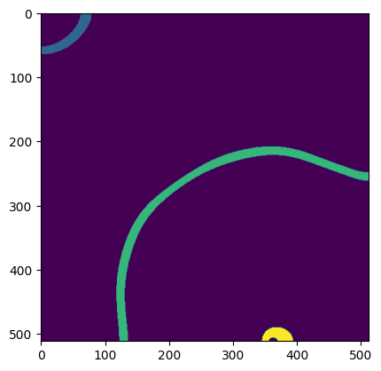
SpeedMeasure.gen_activation_map

Slide 11
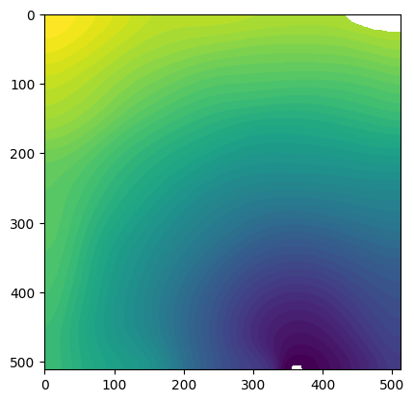
SpeedMeasure.gen_activation_map

Slide 13
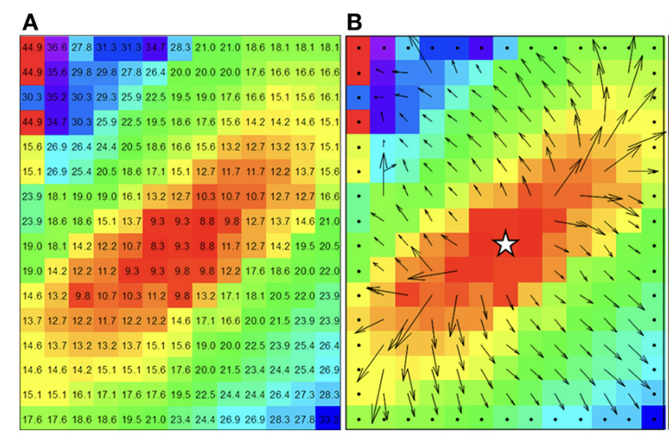
SpeedMeasure.gen_speed

Slide 14
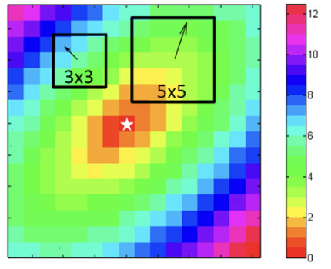
SpeedMeasure.gen_speed

Slide 15
?
Questions

